Slide 1
XG BOOST – REGRESSION

Slide 2
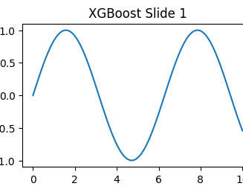
Introduction to XGBoost Regression
XGBoost is an advanced boosting algorithm used for regression problems.
It improves prediction accuracy by combining multiple decision trees.
Widely used in machine learning and data science applications.

Slide 3
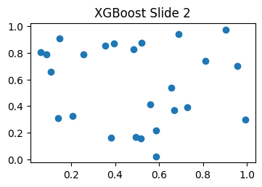
How XGBoost Regression Works
Builds trees sequentially to reduce prediction errors.
Uses gradient boosting technique for model optimization
Final prediction is obtained by combining all weak learners.

Slide 4
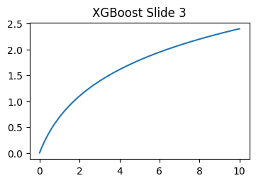
Features of XGBoost Regression
Provides high accuracy and fast performance.
Includes regularization to reduce overfitting.
Handles missing values and large datasets efficiently.

Slide 5
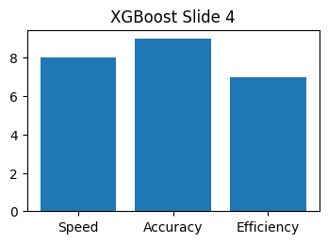
Advantages and Limitations of XGBoost
Advantages:
High speed and better prediction performance
Limitations:
Requires parameter tuning for best results.
Training process can be computationally expensive.

Slide 6
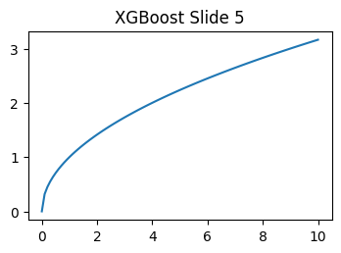
Applications of XGBoost Regression
Used in finance for stock and sales prediction.
Applied in healthcare and customer analytics.
Helpful in forecasting and business intelligence systems.

